Slide 1
Information Gathering
Open Source Intelligence (OSINT)

Slide 2
Google Dorks!

Slide 3

What are Google Dorks?
Answer: The best way to refine Google & database searches for OSINT (& schoolwork)!
https://www.sans.org/security-resources/GoogleCheatSheet.pdf
https://cve.mitre.org/

Slide 4
Practice
What is the CVE of the original POODLE attack?
What version of VSFTPD contained the smiley face backdoor?
What was the first 1.0.1 version of OpenSSL that was NOT vulnerable to heartbleed?
What was the original RFC number that described Telnet?
How large (in bytes) was the SQL Slammer worm?
Samy is my…

Slide 5
Answers
CVE-2014-3566
Version 2.3.4
Version 1.0.1g
RFC 854
376 Bytes
hero

Slide 6
Network Reconnaissance!

Slide 7
CLI Tools: nmap
Command from last week:
ip addr show | grep <network interface> | grep inet | awk ‘{print $2}’
nmap -<options> <ip/subnet or address>
-sn - ping scan (essentially is ping 8.8.8.8 via CLI)
-sS - SYN or Normal scan
-sU - UDP scan
-p<start num-end num>
Default is 1-1024
Max port = 65535
-sV - list all the services (+ version) running on the target
-O - OS detection
-Pn - treat all hosts as up up
-A - runs nmap scripts, -O, -sV, & traceroute

Slide 8
Other Useful CLI Tools:
traceroute <ip or address> - shows all the hops from your machine to the ip/address
netdiscover -i <interface/subnet>

Slide 9
DNS Reconnaissance!

Slide 10
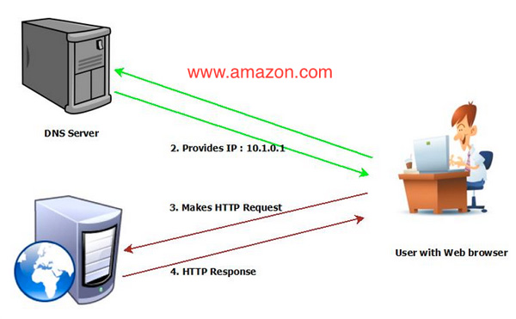
What is a DNS?
DNS = Domain Name Servers
Common DNS’s:
Google- 8.8.8.8 (8.8.4.4)
Cloudflare- 1.1.1.1 (1.0.0.1)
Why are they important? - They hold the records for websites and they are the key player for navigating to websites
Why they are good: they make navigating to websites way easier
Cons: if you take out a DNS, you effectively cut off access to that part of the internet
ex: the Cloudflare DOS (July 2019)*
Notes:
*Attack was believed to be traced to the Chinese Govt. originally (Source; https://www.datacenterdynamics.com/analysis/cloudflare-ceo-talks-outage-was-entirely-our-problem-was-mistake-which-we-made/
https://www.datacenterdynamics.com/news/cloudflare-goes-down-outage-caused-network-performance-issues/)

Slide 11
Command 1: nslookup + host
DNS test host: zonetransfer.me
host <hostname> (or the ip)
host -t <record type> <hostname>
host -l <hostname> <DNS nameserver>
nslookup
set type= <record type>
<hostname>
Record type can be any for all the DNS records
Record types:
mx= email (mail exchange)
a= address
aaaa= IPV6 address
ns= name server (aka who is their DNS)

Slide 12
Command 2: dig
dig <hostname>
dig <hostname> -t [record type]
dig <hostname> [record name]
dig <hostname> -t [record type] +short
dig axfr <hostname> @[name server]

Slide 13
Tool for the Day:
Maltego!

Slide 14
What is Maltego?
Short answer- Tool for automating information gather
Long answer- this tool uses transforms, or modules, in order to search a specific target for reconnaissance within scope
CE is free with a bunch of good transforms from Shodan, DNSDB, and others
Test sites: www.000webhostapp.com or zonetransfer.me
**I am not responsible for what you do with this tool after you gather the information**

Slide 15
Importing an OVA

Slide 16
What is an .OVA and how to install
OVA - Open Virtual Appliance (aka prebuilt machine that has been exported)
Find the OVA you would like to use (ex: https://bit.ly/2kSa6rh) & download
Open VirtualBox and Select File → Import Appliance
Navigate to where you downloaded your OVA → Open → Next → Import

Slide 17
CLI Practice

Slide 18
OverTheWire by Bandit
Pair up & whichever team captures the most flags gets swag!
https://overthewire.org/wargames/bandit/
How to get into level 0
ssh bandit.labs.overthewire.org -p 2220
For this level: Username/Password: bandit0

Slide 19
Extra resources:
Hackersploit: https://hsploit.com/
Hak5 CLI: https://bit.ly/2PdQQBN

